Slide 1

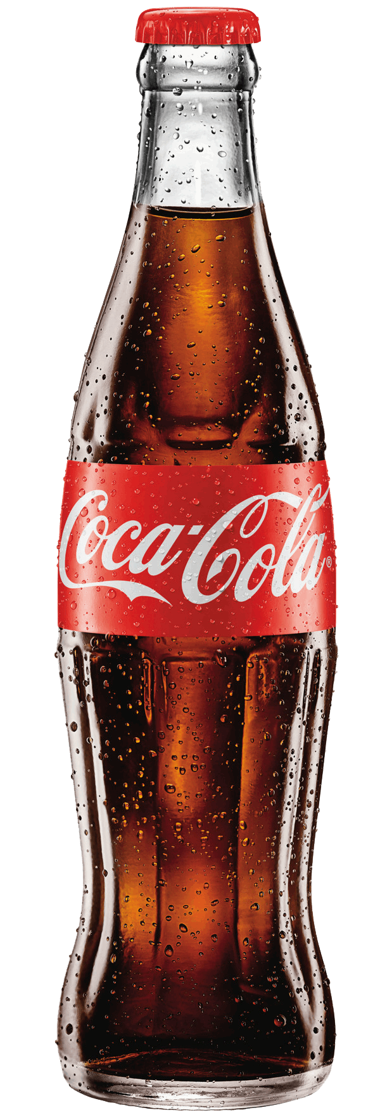
COCA COLA
COCA COLA
The Coca-Cola Company
COCA COLA
Group 3
Eujin Kang, Jose Medrano, Patrick Green, Shuhan Chen, Yoojin Hong
COCA COLA

Slide 2
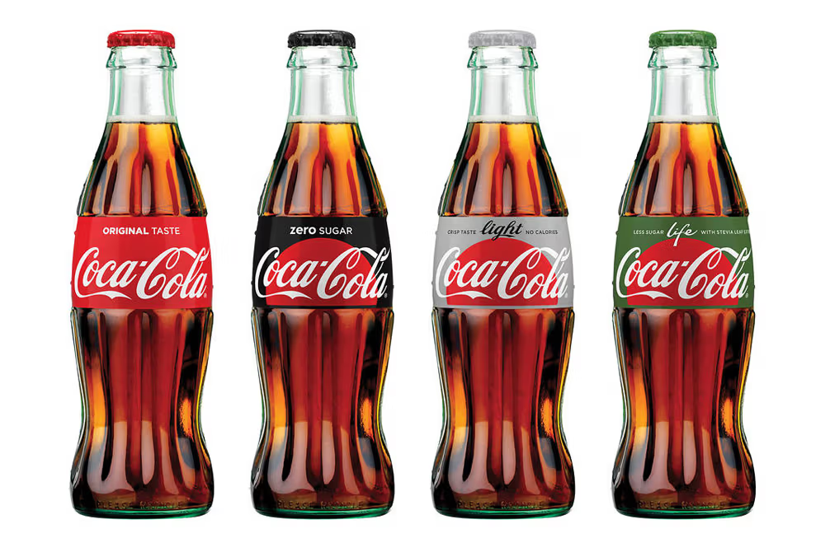
Table of Contents
p. 3 Executive Summary
p. 5 Recommendation 1
p. 8 Recommendation 2
p. 11 Recommendation 3
p. 13 Summary

Slide 3

Executive Summary
Expanding Healthy Products and Tap Into New Markets
Act 1
Coca-Cola has built its sugary product reputation through beverages like Coca-Cola Classic, Cherry Coke, and Vanilla Coke, known for their high sugar content and satisfying taste. Marketing efforts and widespread availability have strengthened its association with sugary sodas, establishing its global leadership. Its portfolio also includes fruit-flavored sodas and energy drinks, reinforcing its image as a provider of indulgent, sweetened beverages.
Act 2
The Health Drinks Market size is expected to grow from USD 344.36 billion in 2023 to USD 408.80 billion by 2028, at a CAGR of 3.49% during the forecast period (2023-2028)
Act 3
Expanding its healthy drink offerings allows Coca-Cola to tap into the health-conscious consumer market using its strong brand recognition and expertise in beverage production. By meeting the demand for healthier options, Coca-Cola aligns with changing consumer preferences and showcases adaptability in the beverage industry.
Notes:
Act 1: Coca-Cola has earned its reputation for sugary products primarily through its beverages like Classic Coca-Cola Classic, Cherry Coke, and Vanilla Coke. These drinks are typically high in sugar content and provide customers with a sweet and satisfying taste experience. Over the years, Coca-Cola's marketing efforts and widespread availability have further reinforced its association with sugary sodas, solidifying its position as a leading producer of such products globally. Additionally, Coca-Cola's portfolio has included other sugary beverages like fruit-flavored sodas and energy drinks, contributing to its image as a provider of indulgent, sweetened beverages.

Slide 4
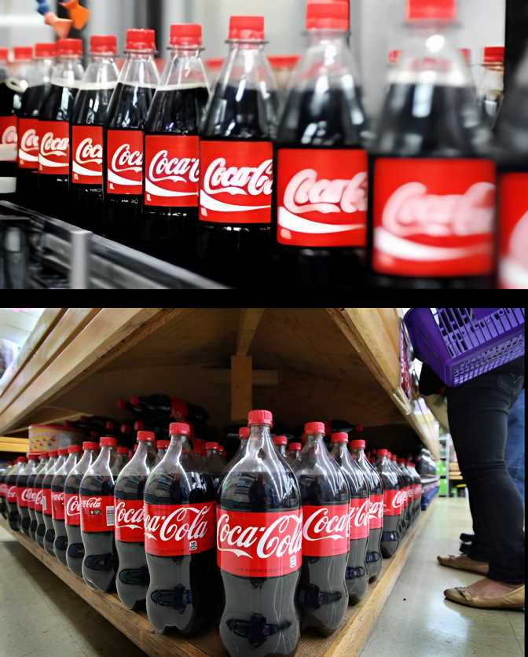
Recommendations
Expand the Menu of Different Healthy Products to Reach New Customers
Partner with Leading Health Organizations
Acquire Athletes and Sports Teams to Sponsor Healthy Products

Slide 5

Expand the Menu of Different Healthy Products to Reach New Customers
Expanding the menu of different healthy products refers to diversifying Coca-Cola's offerings beyond its traditional beverages to include a wider range of healthier options. This expansion aims to attract new customers who may be seeking alternatives to sugary drinks or who have specific dietary preferences.
Notes:
increase option

Slide 6
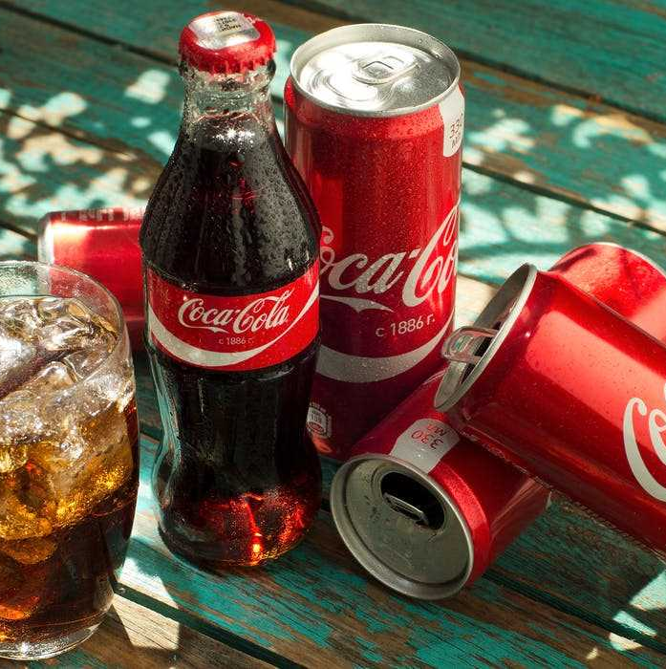
Full Year 2020 Results
Net revenues declined 5%: $8.6 billion
zero-sugar line of Coca-Cola sales growth: 3%
There could be several reasons for this decline. It may be due to decreased consumer demand, changes in consumer preferences, economic factors affecting purchasing power, or shifts in the competitive landscape.
Expanding into healthier products aligns with changing consumer preferences, regulatory trends, and the broader shift toward health and wellness. By offering a variety of beverage options, including healthier choices, Coca-Cola can maintain its relevance in the market and position itself for long-term growth and success.

Slide 7

How Will We Expand Options?
Encourage consumer feedback and incorporate feedback into product refinement and marketing strategies
By listening to consumers, Coca-Cola can gain valuable insights into what they like or dislike about its products and how they can be improved. This feedback is then used to refine existing products, develop new ones, and adjust marketing strategies to better meet consumer needs and preferences
Shift the main focus of drinks to low calorie and healthy products
By prioritizing the development and promotion of low-calorie and healthy products, Coca-Cola can better cater to these changing preferences and tap into the growing demand for healthier beverage options.
Notes:
implement this strategy. target marketing
strategy to make this a successful transition. original

Slide 8

02. Partner with Leading Health Organizations
Partnerships can help companies like Coca-Cola address health concerns associated with their products while still meeting business objectives. These collaborations can be essential in adapting to changing consumer preferences and maintaining a competitive edge in the market.

Slide 9
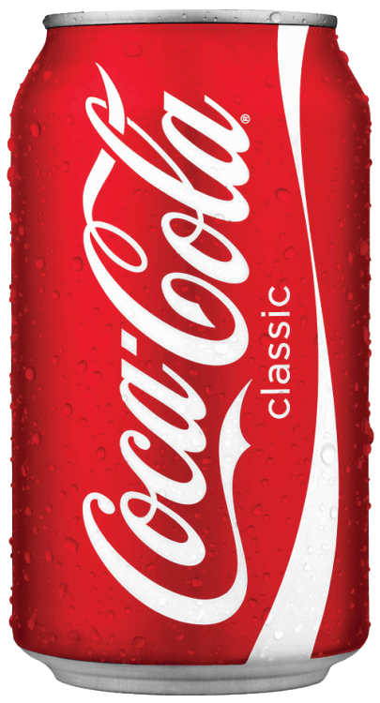
The Benefits of Coca-Cola Partnering with Health Organizations
Coca-Cola partners with health organizations like the American Heart Association (AHA) to combat negative perceptions of sugary drinks. These collaborations involve funding research and public health campaigns.
Co-branding efforts with the AHA on products like Diet Coke associate the brand with health awareness. A post-launch survey showed a significant increase in consumer perception of Coca-Cola as health-conscious, rising from 28% to 45%.
Notes:
Coca-Cola's partnerships with health organizations like the American Heart Association (AHA) tackle negative perceptions of sugary drinks head-on. These collaborations go beyond symbolism, involving substantial initiatives like funding heart health research and public health campaigns. Co-branding efforts with the AHA on products like Diet Coke associate the brand with health awareness rather than just refreshment.
A post-launch survey of co-branded products revealed a significant improvement in consumer perceptions. Before the partnership, only 28% viewed Coca-Cola as health-conscious. After the campaign, this figure rose to 45%, indicating a notable shift in public perception.

Slide 10

How?
Coca-Cola meets the demand for healthier options with Coca-Cola Life, a product tailored to health-conscious consumers.
Sweetened with a blend of sugar and natural stevia, it offers a 30% calorie reduction compared to traditional Coca-Cola.
Developed in collaboration with health organizations, Coca-Cola Life taps into the trend for natural ingredients and lower calories.
This initiative demonstrates Coca-Cola's commitment to innovation and adapting to consumer preferences, reinforcing its image as a forward-thinking brand.

Slide 11

03. Acquire Athletes and Sports Teams to Sponsor Healthy Products
Athletes and sports teams engage with a vast audience and market, igniting inspiration among fans to purchase and experience the products. Their ability to ignite passion and inspiration among fans fuels a thriving market for drinks and beverages. Through their performances, athletes and sports teams captivate audiences, them to connect with their favorite teams and players on a deeply emotional level.

Slide 12



The Influence of Athletes on People Worldwide
Why?
How?
- Cristiano Ronaldo's global influence was evident during Euro 2020.
- In a pre-match press conference, he moved two Coca-Cola bottles out of view, urging people to drink water instead.
- This action resulted in a $4 billion drop in Coca-Cola's market value, demonstrating Ronaldo's significant impact.
- This incident highlights how his promotion of healthier choices regarding Coca-Cola products can also be highly influential.
- Prime energy drink achieved $250 million in sales in 2022, soaring to projected annual sales of $1.2 billion in 2023.
- Strategic partnerships and endorsements from prominent athletes and teams such as L.A. Dodgers, Arsenal, Barcelona, Patrick Mahomes, and Erling Haaland were crucial.
- These collaborations fueled Prime's financial success.
- They also expanded the brand's global reach, captivating consumers worldwide.

Slide 13
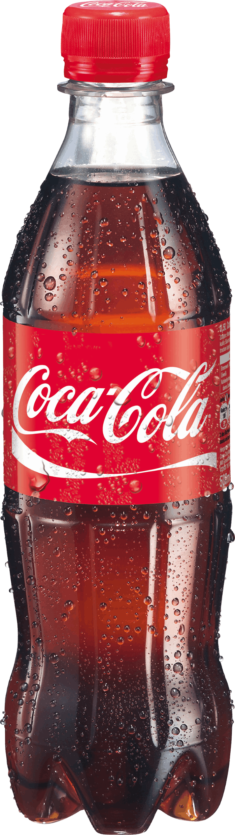
Summary
For Coca-Cola to thrive in the changing landscape of consumer preferences towards healthier options, it's crucial to stay informed of market trends. Demonstrating adaptability by offering healthier choices is key to accessing new markets and broadening its consumer base.
Expanding the range of healthy products, forging partnerships with esteemed health organizations, and sponsoring athletes and sports teams to endorse these products can effectively tap into new markets. This strategy not only cultivates new revenue streams but also contributes to generating additional wealth for the company.
Notes:
It is essential for Coke to keep up with new market trends regarding healthy products. To effectively access new markets and broaden its consumer base, Coca-Cola must demonstrate adaptability to evolving health-conscious trends by offering healthier choices to its customers.
By expanding the menu of different healthy products, establishing partnerships with reputable health and wellness organizations, and acquiring athletes and sports teams to sponsor healthy products will ultimately reach to a growing and new market. As a result, this approach cultivates new revenue streams but also contributes to the generation of additional wealth.

